Slide 1

Secure From Scratch
Secure From Scratch
With security in mind,
From the first line of code

Slide 2

After this workshop
Write code with less security vulnerabilities

Slide 3





Notes:
Until recently, I was a developer and not very concerned about security. Which means my code had zero security problems.

Slide 4
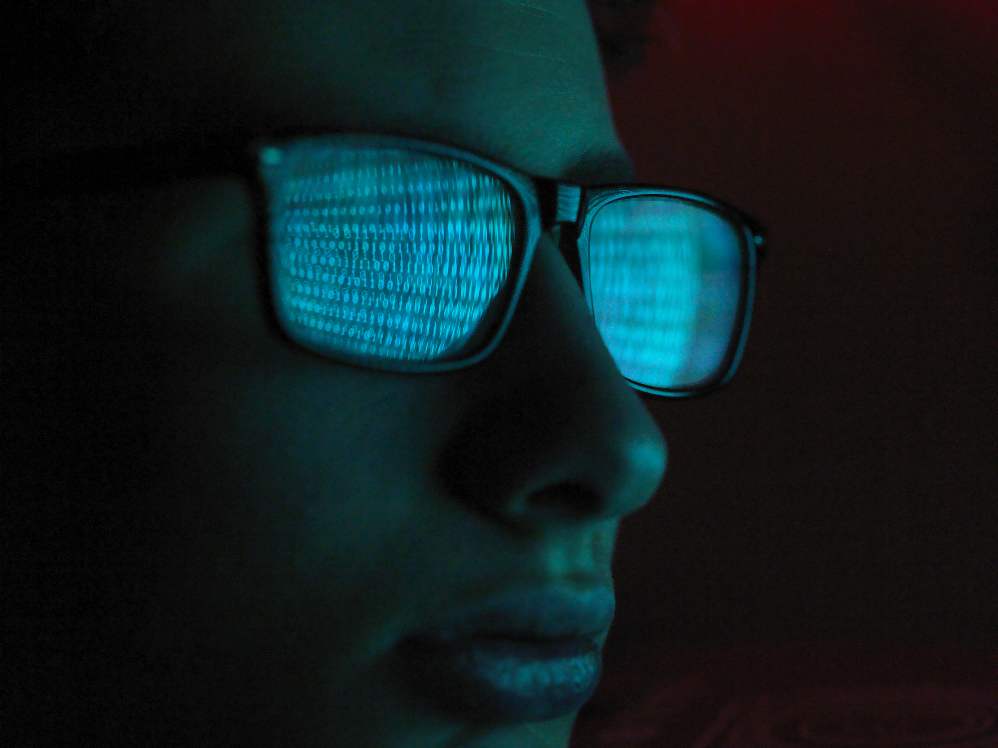
…remotely playing recorded videos…
…unsanitized user input
Notes:
Since I met Or, I started to learn about the world of security.
One day we researched an open-source surveillance solution that allows remote access to cameras and recordings.
The solution contained a feature that remotely allowed playing recorded videos using your default media player.
It was implemented by concatenating unsanitized user input to an OS command and executing that.

Slide 5
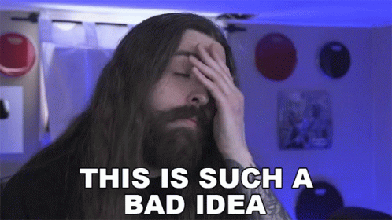
Notes:
I was shocked.
This was a smart developer. He wrote a great commercial quality product by himself.
Doesn’t he know never to use unsanitized user input?
But, then again, I shouldn’t be surprised. Many developers never learn about security.

Slide 6
Demo
Notes:
https://github.com/ispysoftware/iSpy/blob/eb0094c49ef9545ee52d4a0eeadb5acd71730fe9/Server/LocalServer.cs
https://medium.com/@securylight/ispy-c86019163cc1

Slide 7
string fn = GetVar(sRequest, "fn"); ... case "playfile": { try { string subdir = Helper.GetDirectory(otid, oid); string filename = Helper.GetMediaDirectory(otid, oid); ... filename += subdir + @"\" + fn; try { Process.Start(filename);
Request URL
Notes:
https://github.com/ispysoftware/iSpy/blob/eb0094c49ef9545ee52d4a0eeadb5acd71730fe9/Server/LocalServer.cs
https://medium.com/@securylight/ispy-c86019163cc1

Slide 8
sRequestedFile = sRequest.Substring(iStartPos); … sPhysicalFilePath = (sLocalDir + sRequestedFile).Replace("%20", " ").ToLower(); var bHasAuth = sPhysicalFilePath.EndsWith("crossdomain.xml") || CheckAuth(sPhysicalFilePath);
Request URL
Notes:
https://github.com/ispysoftware/iSpy/blob/eb0094c49ef9545ee52d4a0eeadb5acd71730fe9/Server/LocalServer.cs
https://medium.com/@securylight/ispy-c86019163cc1

Slide 9
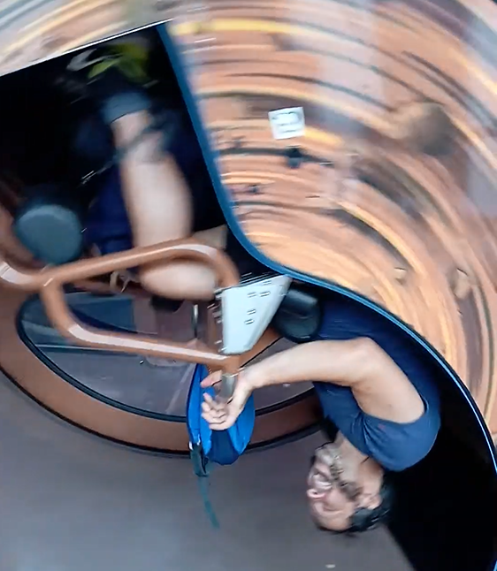
Yariv Tal
University lecturer
Bootcamps mentor
Seasoned developer (WhyT software)
Application security researcher
Drug of choice: Travelling & Roller coasters

Slide 10
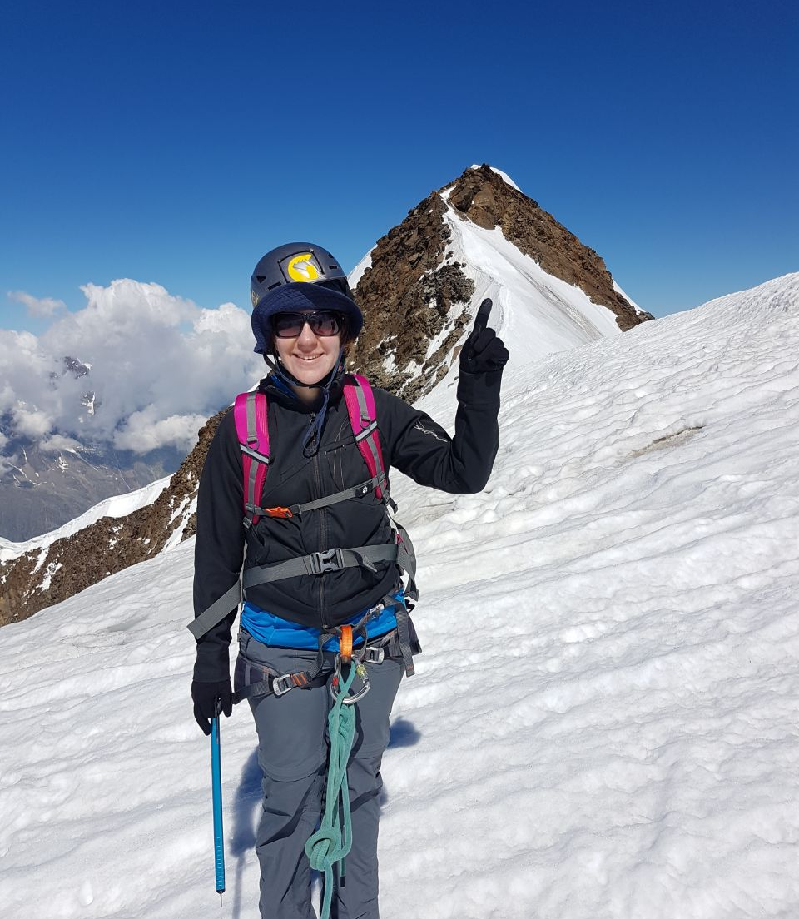
Or Sahar
Senior security researcher
Secure code Instructor
Application security consultation and PT
A veteran developer
Drug of choice : CVEs & Snowy mountains
Notes:
My name is Or Sahar.
I was a developer and developer team lead for many years.
A few years ago, at the age of 40, I switched to application security consultation and penetration testing.
Later on, I focused on application security research.
Today I’m a senior security researcher.
My drug of choice is chasing CVES, and climbing snowy mountains.

Slide 11
Getting to Know You
Backend/Front end?
Java/C#/Python/C++/NodeJS/Typescript/Other?
Experience?
Security knowledge?
i++ or ++i?

Slide 12
What Is This Workshop About?

Slide 13
This is a Secure Programming Workshop
It’s a mindset
Can be applied to any programming language
Programming, nothing more.
Not SDLC, Secure By design, Threat modeling etc.

Slide 14
What is Secure Programming?
Programming that leads to less Security Bugs
Secure coding is … developing computer software in such a way that guards against the accidental introduction of security vulnerabilities.
Defects, bugs and logic flaws are consistently the primary cause of commonly exploited software vulnerabilities.
… most vulnerabilities stem from a relatively small number of common software programming errors.
Wikipedia

Slide 15
What is a Security Bug?
A bug that leads to a security vulnerability.

Slide 16
What is a Security Vulnerability?
So many (incomplete) definitions!
In OWASP We Trust:
A vulnerability is a hole or a weakness in the application .. that allows an attacker to cause harm to the stakeholders of an application.
Stakeholders include the application owner, application users, and other entities that rely on the application.

Slide 17
The Goal of Secure Programming
Less Security Bugs
→ Less Vulnerabilities
→ Less Exploitations
→ Less Harm

Slide 18
The Goal of Secure From Scratch
Involve in the developers’ careers ASAP
Make Secure Programming the default
Form good habits

Slide 19
PREVENT - SFS Principles
Priority – Security is the first priority
Reporting & logging
Easy to use securely
Verify
Errors & exceptions
Neat code
Trust Boundaries

Slide 20
Workshop Outline
The Need for Secure Coding
Getting To Know The Lab Environment
Hacking is Unexpected Input
Validation
Let Me Convince You: Blocking Doesn’t Work!
Summary

Slide 21
Part 1: The Need
Notes:
There are many articles and courses that explain the cost of vulnerabilities
in this workshop we’ll not elaborate about it.
if you find it’s interesting to to jfgi.com

Slide 22
Cost of Vulnerabilities - 2023
MOVEit
$9,923,771,385
1000 organizations
60,144,069 individuals
Root cause is SQL injection.
Notes:
MOVEit has a group of products that offer secure and compliant ways to transfer sensitive data between partners, customers, users, and systems
. On may 2023 the vulnerability was disclosed by security firm and already exploited in the wild.
The mass-exploitation of MOVEit Transfer software has rapidly cemented itself as the largest hack of the year so far.
While the full impact of the attack will likely remain untold for months to come,
there are now more than 1,000 known victims of the MOVEit breach, according to cybersecurity company Emsisoft.
This milestone makes the MOVEit breach not just the largest hack of 2023 — but also one of the largest in recent history.
The root cause of MOVEit mass-exploitation is sql injection.

Slide 23
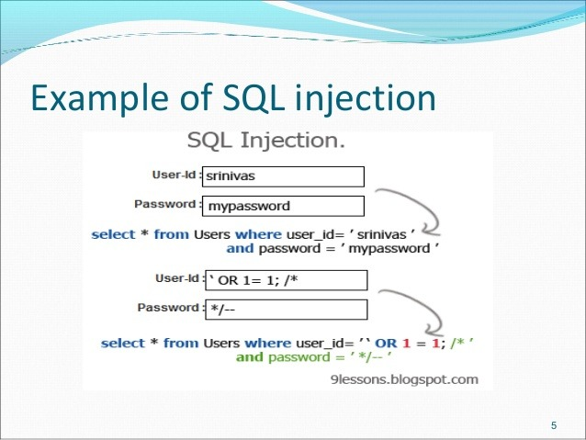
SQL Injection
SQL Injection occurs when an attacker is able to insert a series of SQL statements into a 'query' that an application will execute on its database

Slide 24
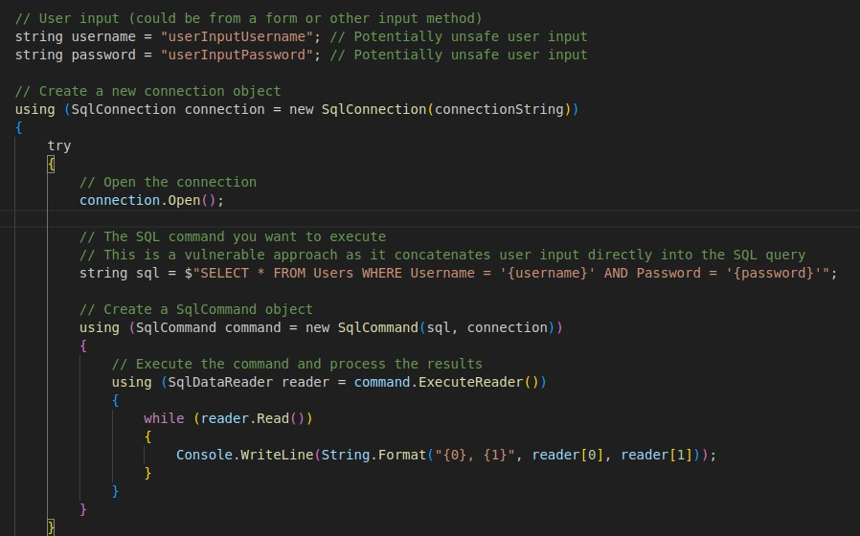
SQL Injection

Slide 25
Part 2: Getting To Know The Lab Environment

Slide 26
Case In-Point – A Shared Machine Quiz App
Shared machine
Users can do a Quiz
Users identify by name
Teacher can see success/failure

Slide 27
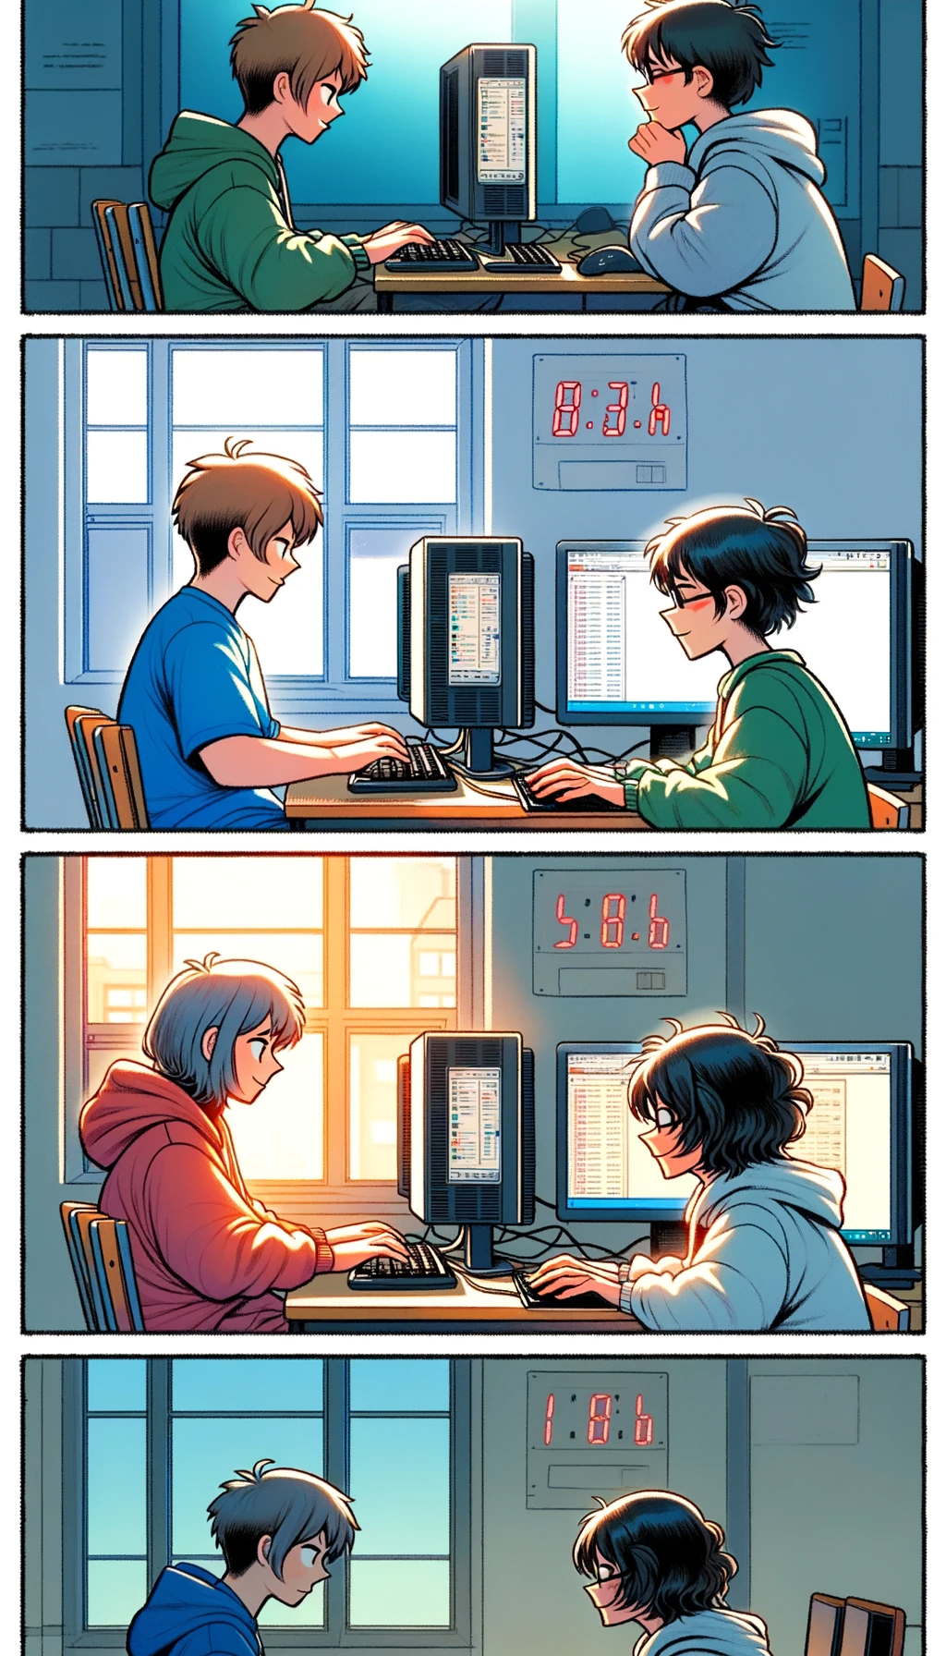
A Shared Machine Quiz App
Shared machine
Security issues require 2 or more users
School lab computers are shared
Internet sites are shared
Users can do a Quiz
Users identify by name
Teacher can see success/failure

Slide 28
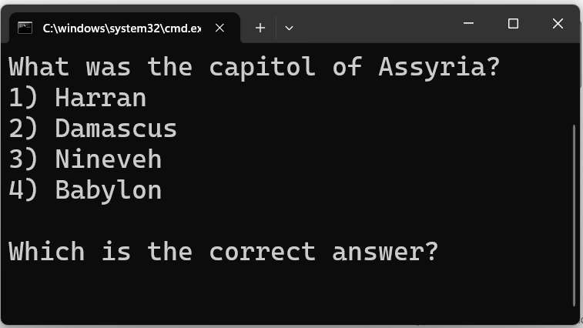
Case In-Point – A Shared Machine Quiz App
Shared machine
Users can do a Quiz
Question will change every day
All users get same question
Users identify by name
Teacher can see success/failure

Slide 29
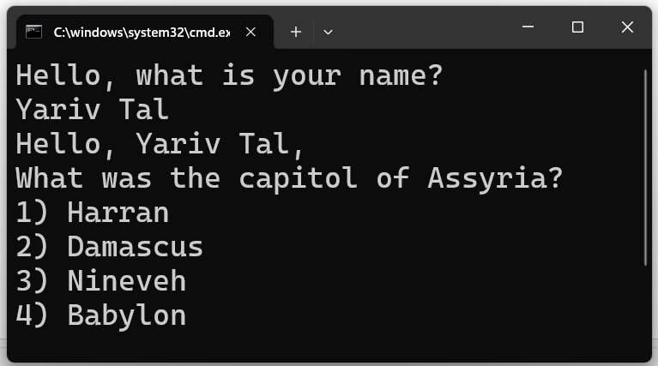
Case In-Point – A Shared Machine Quiz App
Shared machine
Users can do a Quiz
Users identify by name
Teacher can see success/failure

Slide 30
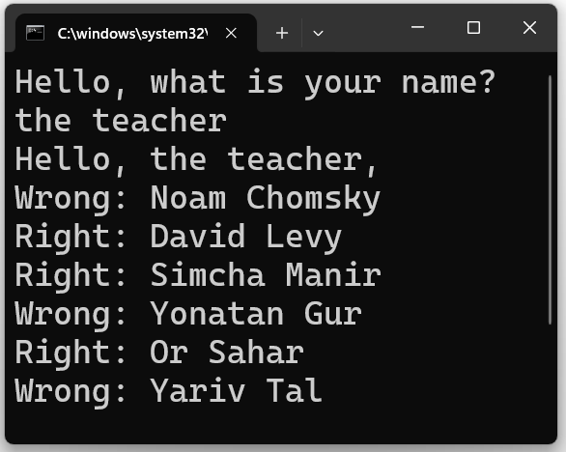
Case In-Point – A Shared Machine Quiz App
Shared machine
Users can do a Quiz
Users identify by name
Teacher can see success/failure
Your goal: Be Right!

Slide 31
Case In-Point – A Shared Machine Quiz App
Shared machine
Users can do a Quiz
Users identify by name
Teacher can see success/failure
Your goal: Be Right!
Your goal: Look like I’m Right!
Right

Slide 32

LAB: Setting up the environment
5 min
In a browser go to: https://github.com/SecureFromScratch/Workshops/
Download the no_network_quiz release file
Extract the zip file (right-click, “extract here”)
Open the created folder
Execute the program
IMPORTANT: Do not look in the spoiler folder!

Slide 33
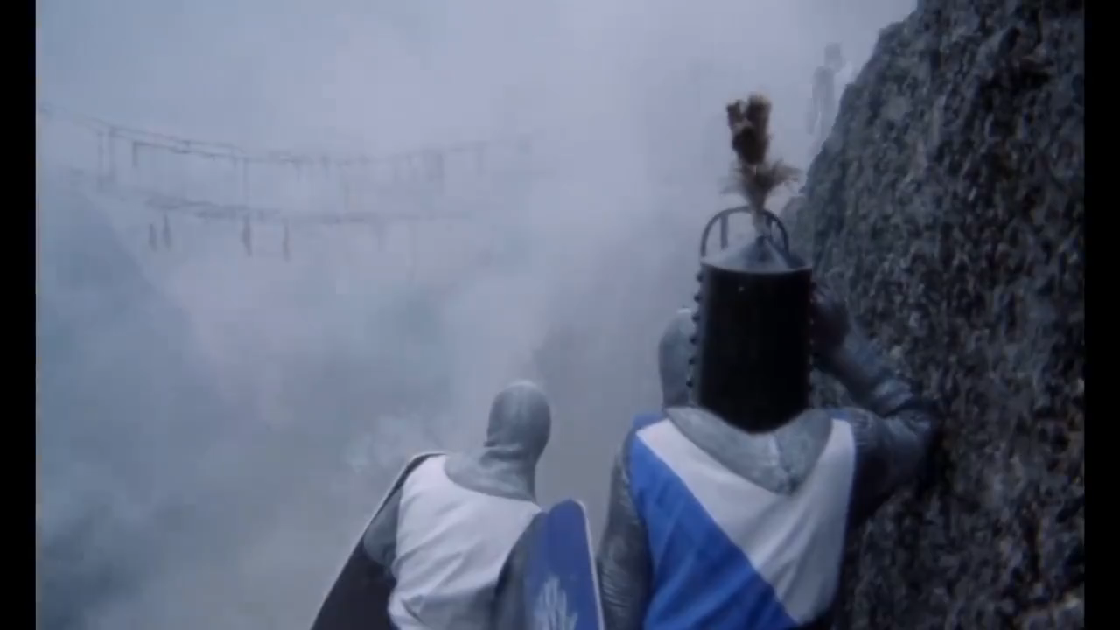
The Inspiration

Slide 34
LAB: Get to know the Quiz App
8 min
Execute the app (quiz.bat)
Enter a name
Answer the question
Execute the app, again
Enter “the teacher” as the name
See the results

Slide 35
Part 3: Hacking is Using Unexpected Input

Slide 36
Your Goal (Reminder)
Teacher can see success/failure
Your goal:
Be Right!
Problem: Requires knowing the answers…

Slide 37
Your Goal (Reminder)
Teacher can see success/failure
Your goal:
Be Right!
Look like you are Right!
How? Do something unexpected!

Slide 38
LAB: Test the Quiz App Inputs
TIP: Make testing easier by putting in a loop
8 min
Execute the app (quiz.bat)
What kind of inputs does it expect?
What protection do these inputs have?
Hint: How long can the name be?
Hint: What happens if you enter a very long name?
Hint: Can you enter text that isn’t a name?
Hint: Can you enter text so it looks like you are right?

Slide 39
Part 4: Validation

Slide 40
Problem: Any Input Leads To Unexpected Input
When entering a name anything is allowed.
Let’s see this in the code…

Slide 41
Code Overview: Any Input = Unvalidated Input
def ask_for_name():
while True:
name = input("Hello, what is your name?\n");
if not " " in name:
print("Your full name, please")
continue return name

Slide 42
Code Overview: Validated Input
def ask_for_answer_number(min_allowed, max_allowed):
...while True:
try:
value = int(input());
if min_allowed <= value <= max_allowed:
return value except ValueError:
pass
print("You must enter an integer number …")

Slide 43
LAB: Add Input Validation to Name
10 min
Change the ask_for_name() method
Test if you can still “cheat” and always look like you’re right

Slide 44
Problem: Your Validation Is (Probably) Not Enough
There are 2 philosophies to validation:
Blocking
Checking that input DOES NOT contain something we don’t allow
Welcoming/Allowing
Checking that the input contains ONLY what we allow

Slide 45
Why Blocking Doesn’t Work
This isn’t blocked!
What We KNOW is Possible
Valid User Input
What IS Possible
What IS Possible
What IS Possible

Slide 46
With Welcoming We Control What Is Possible
What We KNOW is Possible
=
What IS Possible
Valid User Input
What IS Possible
What IS Possible

Slide 47
Welcoming/Allowing
The 2 most important rules of validation:
Always Limit the size/length
This is true for all types of input: strings, numbers, files, …
Use a Welcome List
A list of Legal Values (also known as an Allow List)

Slide 48
Welcoming/Allowing Input
VALID_CHARS = "abcdefghijklmnopqrstuvwxyzABC...YZ '.()"
The Welcome-List
def ask_for_name():
while True: ...
... if len(name) > MAX_NAME_LENGTH:
print(“That is too long" )
continue
if not has_only_valid_chars(name,VALID_CHARS):
print(“Name contains llegal characters" )
continue
return name;

Slide 49
Welcoming/Allowing Input
def has_only_valid_characters(txt, valid_chars):
return all(c in valid_chars for c in txt)

Slide 50
Part 5: Let Me Convince You: Blocking Doesn’t Work!

Slide 51
Attempt 1: Prevent the Word “Right”
Right is a legal surname – cannot disallow it
def ask_for_name():
while True:
name = input("Hello, what is your name?\n");
... if “Right" in name:
print(“Name cannot contain ‘Right’")
continue
return name

Slide 52
Attempt 2: Prevent the Colon (:) Character
Circumvented using alternative unicode character
def ask_for_name():
while True:
name = input("Hello, what is your name?\n");
... if “:" in name:
print(“Name cannot have :")
continue
return name

Slide 53
Attempt 3: Limit the Size
Circumvented using the TAB character
def ask_for_name():
while True:
name = input("Hello, what is your name?\n");
... if len(name) > MAX_NAME_LENGTH:
print("That is too long")
continue
return name

Slide 54
Attempt 4: Prevent the Tab (\t) Character
Circumvented using backspace character
def ask_for_name():
while True:
name = input("Hello, what is your name?\n");
... if “\t" in name:
print(“Name cannot have tabs")
continue
return name

Slide 55
Summary

Slide 56
PREVENT - SFS Principles
Priority, Privacy, Permissions – Security is the first priority
Reporting & logging
Easy to use securely
Verify
Errors & exceptions
Neat code
Trust Boundaries

Slide 57
Summary
Hackers exploit unvalidated input
Hackers exploit badly validated input
Input must be validated
Blocking doesn’t work!
Input validation must take a welcoming approach
Limit size/length
Limit to a welcome-list
Notes:
Security vulnerabilities arise from coding errors.
To improve the situation, we need to change our mindset.
Secure from scratch principles can aid in changing our mindset.
Let's consider how to implement these principles when we engage in programming tasks.

Slide 58
Go Research
Why is it called a Welcome-List and not an Allow-List?
What is a TeleType (TTY)?
What are Control-Characters?
What is Unicode?
Secure From Scratch: PREVENT
The PREVENT Verify Principle
Bounded Resources
Notes:
Security vulnerabilities arise from coding errors.
To improve the situation, we need to change our mindset.
Secure from scratch principles can aid in changing our mindset.
Let's consider how to implement these principles when we engage in programming tasks.

